Slide 1
VET 924: ALT LB3A supplement
Aging the horse using dental cues.

Slide 2
Estimating age from teeth - Equine
Eruption time is a fairly reliable criterion, signs of teeth wearing is much less reliable
In wear at
3
4
5
Permanent incisors: erupt and in wear at = 2.6:3; 3.6:4; 4.6:5
Notes:
We are exploring aging of horses by examining their teeth, and primarily this is by examining their incisor teeth. The most reliable criterion for aging a horse is by the expected eruption time for teeth. Therefore up to 5 years of age, when teeth are erupting (temporary and permanent) and the horse is developing its full mouth of permanent teeth we can be quite accurate with our aging attempts. Of course it is worth remembering that the most accurate way to determine a horse’s age is by reading its birth certificate (or date of birth noted on a registration record). Naturally many horses don’t come with a registration or birth record and we are left to our aging devices. This table is adapted from the AAEP guide to aging horses and lists eruptions times for temporary and permanent teeth. Refer back to it frequently.

Slide 3
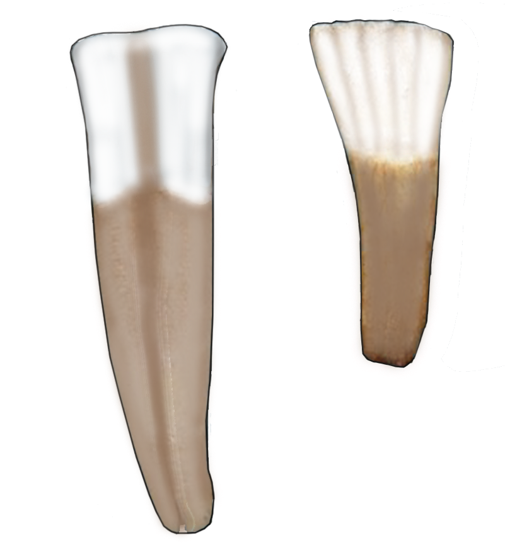
Estimating age from teeth - Equine
Important to distinguish deciduous (temporary) from permanent incisors
Deciduous incisors have a notable neck, are smaller, and have numerous fine grooves
Permanent incisors have no neck, are larger, and typically have only one central groove filled with (stained) cementum.
Occlusal surface observations are made on mandibular incisors only
Notes:
As part of aging a horse 5 years or younger we must be able to distinguish permanent from temporary incisors. There are characteristics that help us do this.
Deciduous incisors have a notable neck, are smaller, and have numerous fine grooves as shown in the image.
Permanent incisors have no neck, are larger, and typically have only one central groove filled with (stained) cementum, as shown in the image.
We will also look at occlusal surface markings and shape and the first thing to remember is that as a rule we observe the occlusal surface of mandibular incisors only – for one thing it is just easier for us to do so! No bending down and trying to look up under a row of maxillary incisors.

Slide 4
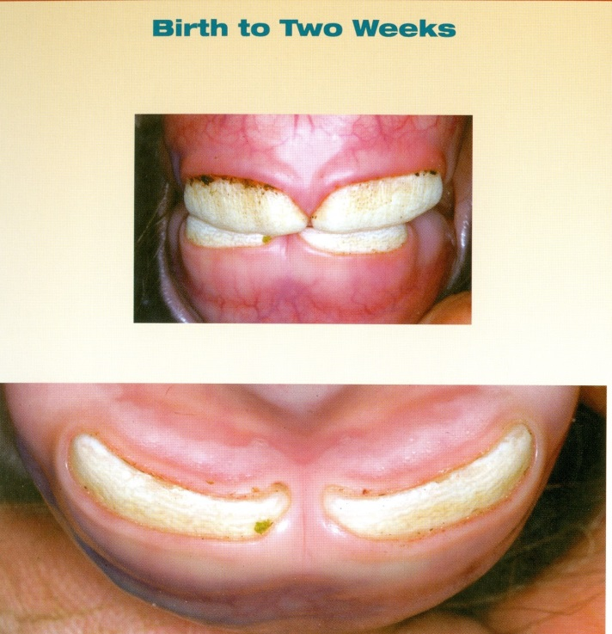
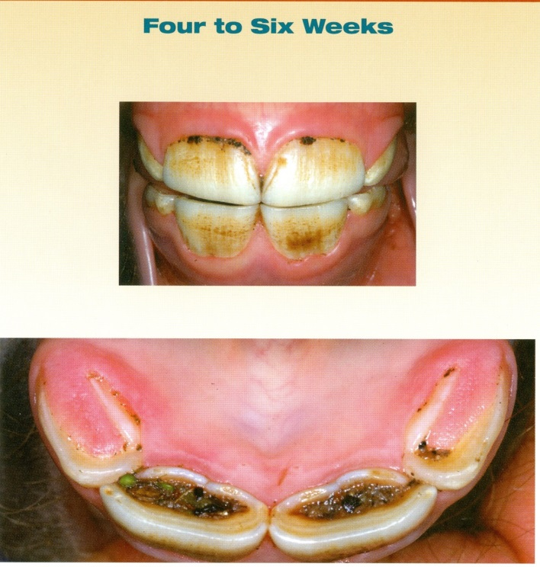
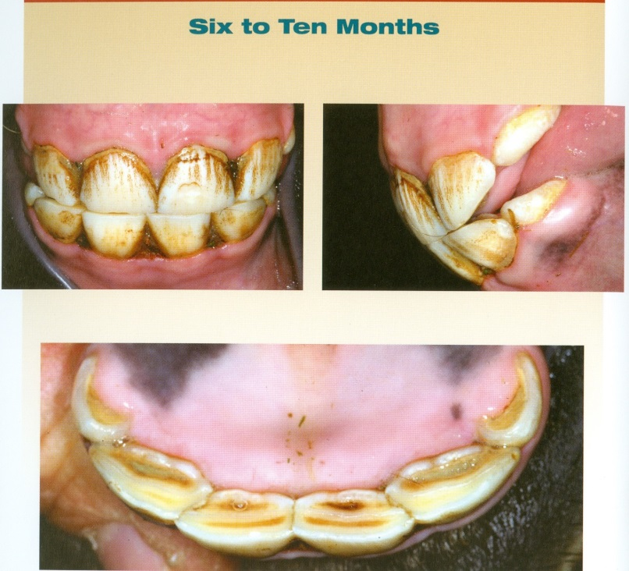
Estimating age from teeth - Equine
Deciduous incisor eruptions
6 days - I1
6 weeks – I2
6 months – I3
In wear (ie contact opposite side) about 6 months after first (appear) erupt
Deciduous incisors have a clam shell appearance, as the tooth narrows to a neck located at the gingival margin, and look for multiple grooves on labial surface
Images from AAEP Guide for Determining the Age of the Horse, 8th Edt, 2010
Notes:
OK, temporary (aka deciduous) incisors erupt from 01 or central incisors to 03 or corner incisors in a sequence of 6 days, 6 weeks, 6 months...roughly. Once erupted it takes about 6 months for the opposing teeth to contact each other when the mouth is closed and therefore to grind against each other – when the teeth have reached this point we refer to them as being “in wear”. Again, teeth coming into wear is about 6 months after they first erupt. The images in this slide walk us through the sequential ages of eruption of the temporary incisors.

Slide 5
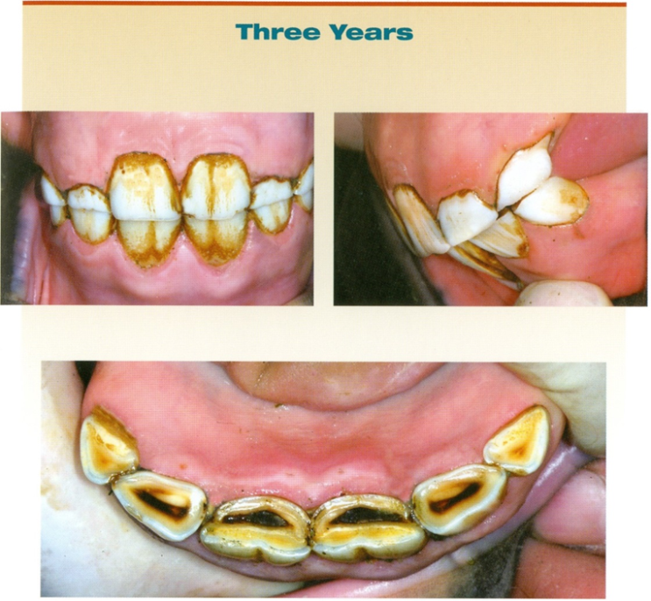
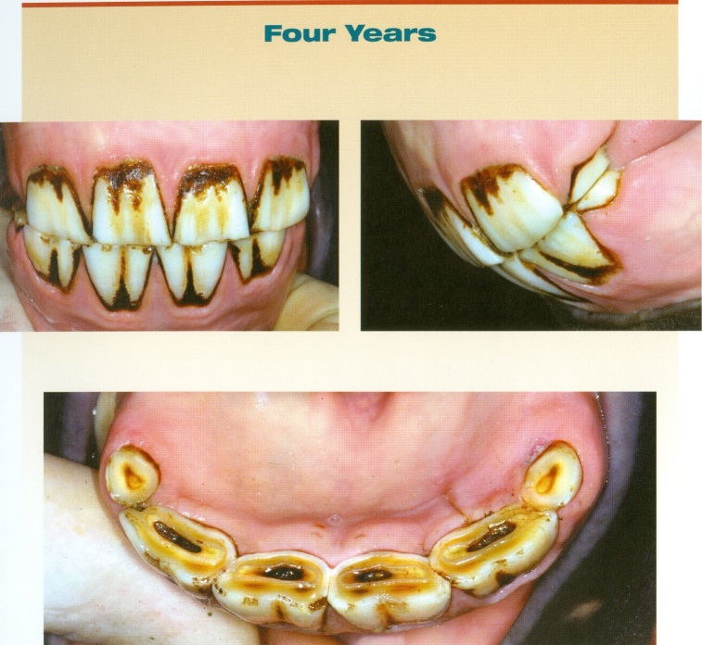
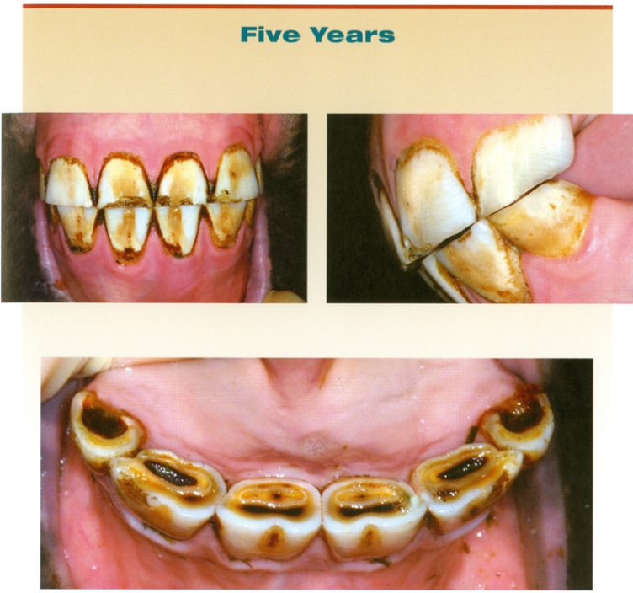
Estimating age from teeth - Equine
Permanent incisor eruptions
I1 – 2.5 yrs, in wear 3 yrs
ie 2.6:3
I2 – 3.5 yrs, in wear 4 yrs
ie 3.6:4
I3 – 4.5 yrs, in wear 5 yrs
ie 4.6:5
Permanent incisors – more square shaped and then become rectangular and usually one obvious groove on labial surface
Images from AAEP Guide for Determining the Age of the Horse, 8th Edt, 2010
Notes:
The next step is to shed those temporary incisors and replace them with permanents! This happens as depicted in the slide. The permanent 01 or central incisors show up at 2.5 years of age and are in wear 6 months later ie 3 years. Then it is 3.5 years, in wear by 4 years, for the second incisors and 4.5 years, in wear by 5 years for the third or corner incisors. I was taught the old 2.6:3, 3.6:4, 4.6:5 combo for remembering this temporal sequence and perhaps it will help you too. Note we are needing to know what looks like a temporary tooth and what looks like a permanent tooth to help us figure out the age.

Slide 6
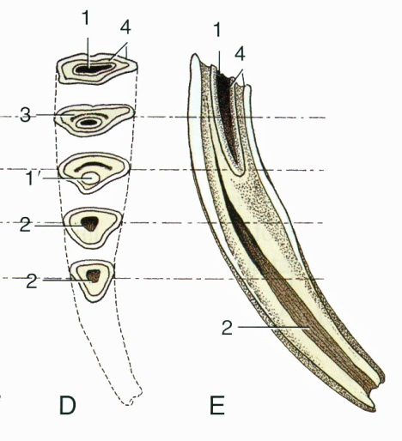
Estimating age from teeth - Equine
Aging from wear is less reliable and requires understanding of incisor anatomy – we use the mandibular incisors as our guide to aging.
Infundibulum with cementum
Infundibula are worn away around 6, 7, and 8 years from I1 to I3
Occlusal surface changes shape from oval to biangular as teeth age and wear
Dental star on labial side of Infundibulum
Enamel mark/spot
Dental star becomes more rounded and central in location
Dental star = stained dentin that overlies and protects the pulp horn (labeled 2)
Notes:
After 5 years or so, with the mouth full of permanent teeth now in wear and slowly changing over the life of the horse, we go from known eruption times to looking for visual cues of wear that allows us to approximate a horse’s age beyond the 5 year mark. Note this process is less reliable than known eruptions times (and birth date records) and it requires a good understanding of incisor anatomy.
Your basic incisor is on the right, cut down its center on a labial to lingual line and positioned like a mandibular incisor. On the left is the appearance of the occlusal surface as the tooth wears and ages.
Incisors have an infundibulum (latin for funnel shape, as used for infundibulum of uterine tube and pituitary gland) or funnel like cup in their clinical crown and this structure is worn away over time. The cup is an infolding of enamel developmentally, filled with cementum. The cup is reduced to a spot of enamel (enamel spot or mark as labeled) at its base by about 6 years for I1, 7 years for I2 and 8 years for I3. So that helps figure out 6, 7 and 8 year old horses. Remember all this is determined from looking at the mandibular incisors, the maxillary incisors are not invited to the aging party.
Another feature to show up on the occlusal surface with wearing is the dental star - this is a brownish mark that represents the stained secondary dentin that overlies and protects the pulp horn. The star takes the shape of the underlying pulp horn so it starts out as a thin line and becomes more rounded and central in location as the tooth ages. Note the star lies on the labial side of the infundibulum and enamel mark when those features are present. This makes sense as the pulp horn slides up the tooth and runs labial to the infundibulum as you can see on the midline section. Eventually the enamel mark is worn away too, and what is left occlusally is the dental star.
Lastly look at the changing surface shape as the incisor ages – oval in younger teeth, triangular or biangular in very old teeth.

Slide 7
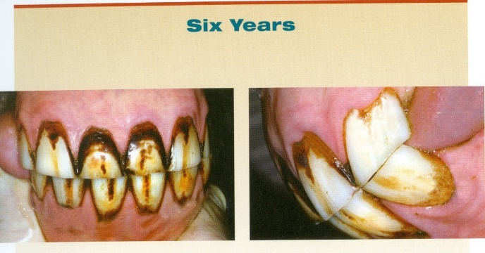
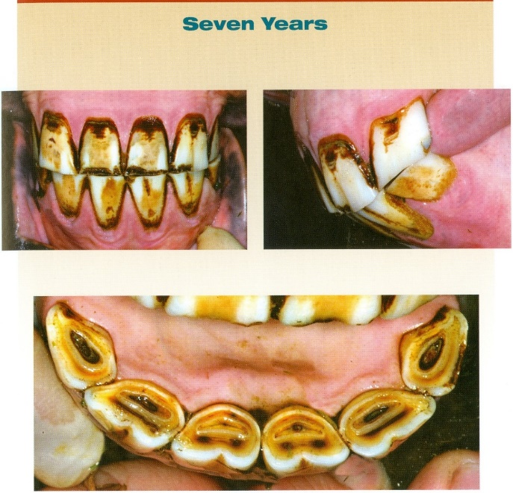
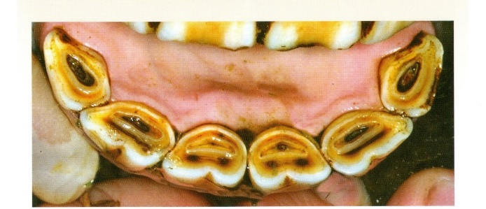
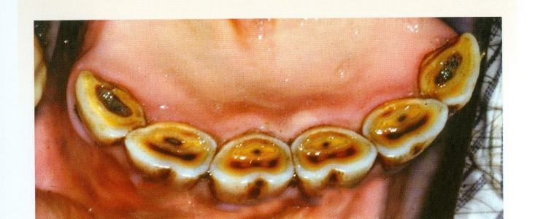
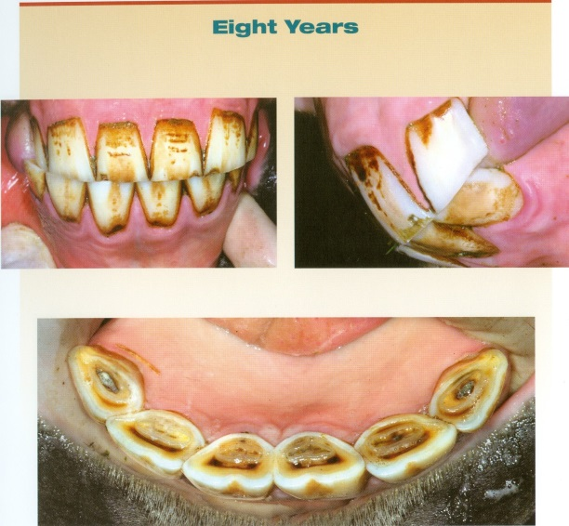
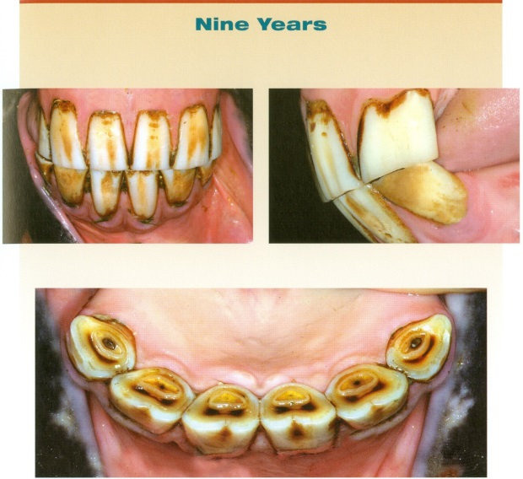
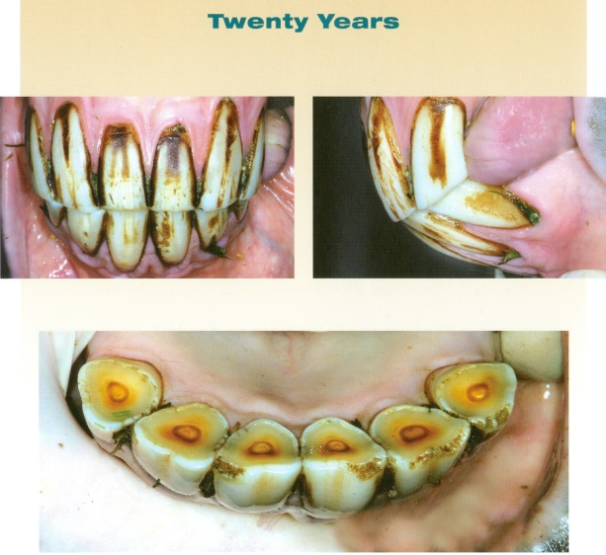
Estimating age from teeth - Equine
Images from AAEP Guide for Determining the Age of the Horse, 8th Edt, 2010
Notes:
Here are images showing 6, 7, 8, 9 years and then 20 years. Look at the cups being worn down and then look at 20 years and note the triangular shape to the teeth and no enamel mark/spot left. What we see is the rounded dental star by this age. The cup wearing sequence is a guide only – things can look different to what might be expected.

Slide 8
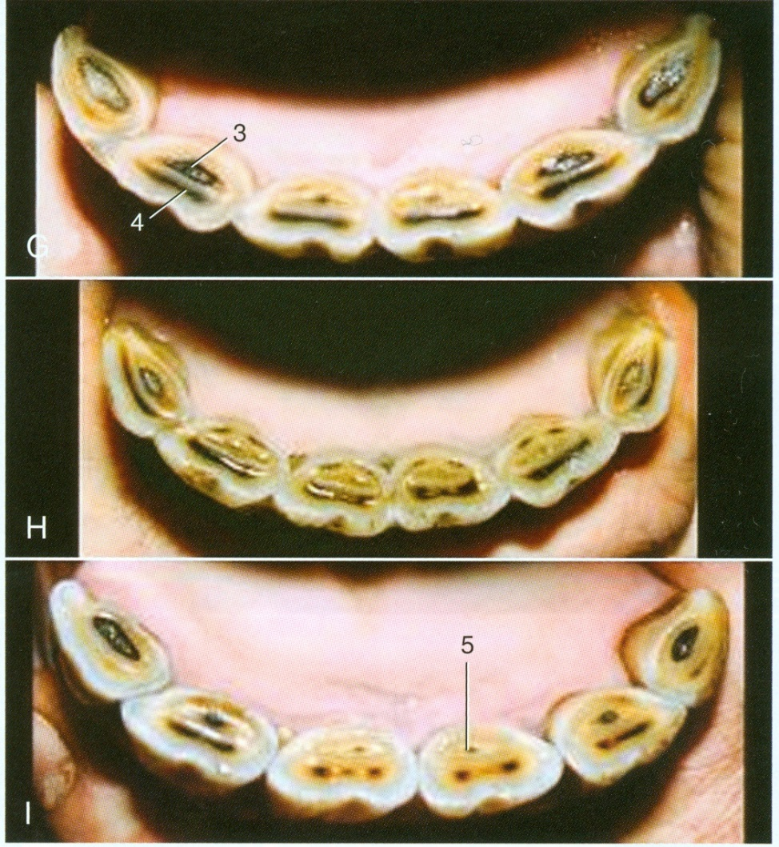
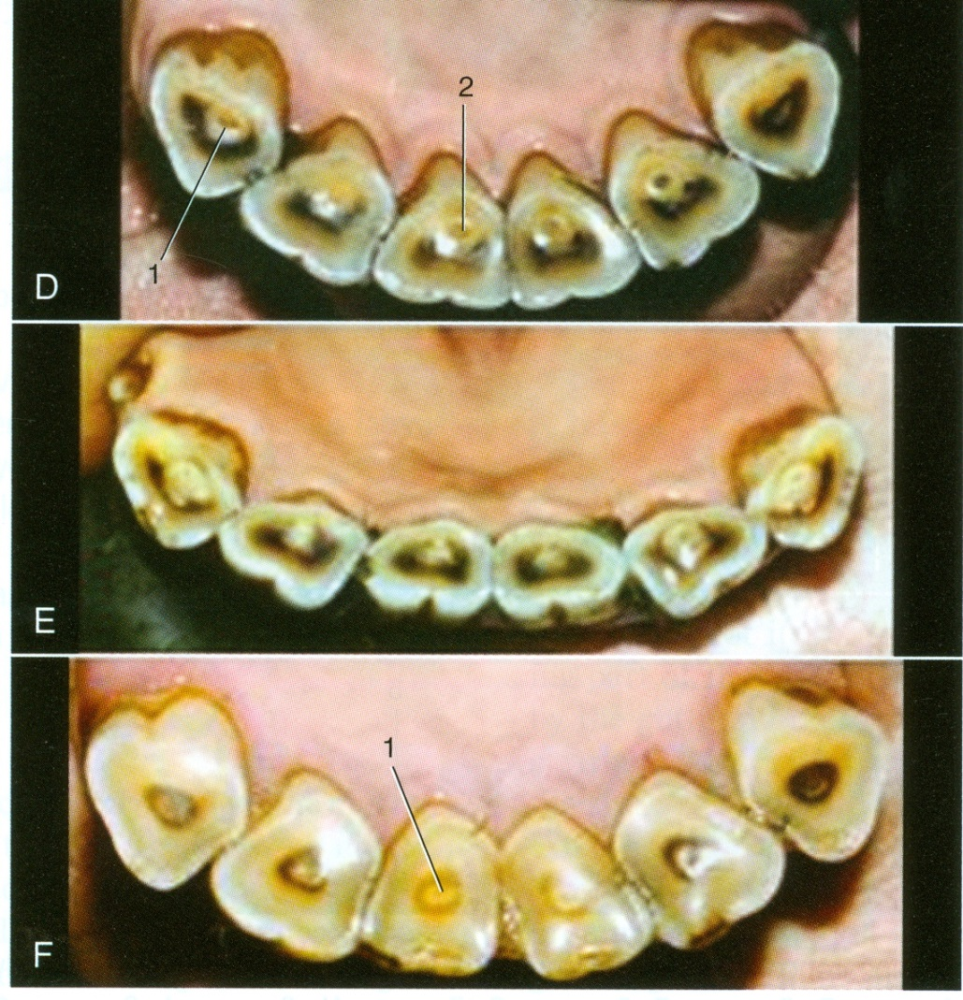
Estimating age from teeth - Equine
Occlusal surface shape - Oval to biangular over time
7 years
16 years
8 years
17 years
9 years
20 years
Textbook of Veterinary Anatomy, 4th edt
Notes:
Here is another sequence of images, and focus on the occlusal surface shape changes here. Oval through to triangular or sometimes called biangular. Based on the surface shape do you think you could tell a 9 year old from a 20 year old? We can also look for loss of enamel marks in the older horse and appearance of dental star.

Slide 9
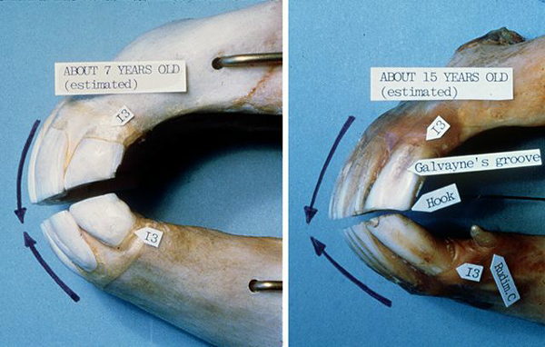
Estimating age from teeth - Equine
Side profile angle changes, and Galvayne’s groove on maxillary I3
Galvayne’s groove – Maxillary I3: appears at 10 years, half way down at 15 years, all the way at 20 years, half way gone by 25 years, all gone by 30 years
Notes:
Two other items to consider for aging cues.
Looking at the incisor arcade profile from a lateral perspective (this is one of the times we do focus on maxillary incisors) note how the angle of the arcades changes from a vertical orientation to a more acute orientation angle as the maxillary and mandibular arcades appose each other. The horse literally gets long in the tooth as it ages and mandibular and maxillary arcades meet each other at a tighter angle.
Galvayne’s groove - And this is one other time we will focus on a maxillary incisor to examine this cue. Also note it is probably one of the more inaccurate aging cues we can discuss and use AND YET, we all still look for it and say something about it☺ So we should know what it is. In the upper corner incisor Galvayne’s groove is the central groove of that tooth on its labial surface. According to Galvayne this groove appears at 10 years of age, is halfway down the tooth at 15 and all the way down at 20. Then it starts to disappear and is all gone if the horse lives to 30 or more.....There, Galvayne’s groove discussed and make of it what you will.

